Slide 1
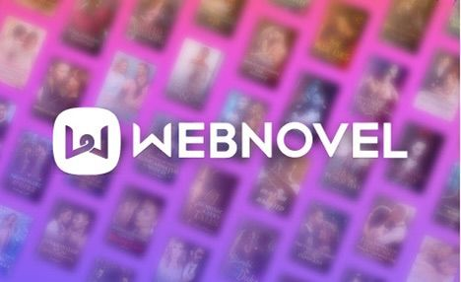
E-book Recommendation A.I. System for an Online Library Pay-to-Read Platform
By Team 9:
Yusuf Saadu
David Ajiga
Soundarya Nidhi Sabanayagam
Prabandha Naraboiena
Image Source:https://www.facultyfocus.com/articles/course-design-ideas/how-and-why-to-evaluate-open-educational-resources-oers/

Slide 2

Introduction
Agenda:
Client Introduction
Problem Description
A.I. Solution Overview
A.I. Approach to Solution
A.I. Algorithm Architecture
Solution Prototype showcase and final vision
Our aim is to create an A.I. novel recommender that can select and present the appropriate books to readers based on their taste and preferences.
Image Source: https://www.mindful.org/how-mindfulness-can-give-us-the-courage-to-examine-bias/

Slide 3

Client Description
Online source that was established in 2017- Singaporean foundation.
Employing 200–500 people.
No physical copies
Monthly subscriptions
Image Source:https://techtechchina.com/webnovel-unlocks-a-new-career-path-for-genz/

Slide 4

Client Problem Description
Challenges faced
Focused Business Areas
Unsubscribed users
Improve the customer experience
Developing and Replacing a Recommendation system
Lack of information on user preferences
Sustain Revenue
Invisibility of Company’s capability
Increasing user traffic and subscriptions

Slide 5









AI Based Solution for Client Problem
Personalized Content
Recommender systems are trained to understand the preferences, previous decisions, and characteristics of people and products using data gathered about their interactions.
Better Product search experience
These include impressions, clicks, likes, downloads, online activity and purchases.
https://www.weforum.org/agenda/2021/12/diversity-inclusion-human-library/

Slide 6
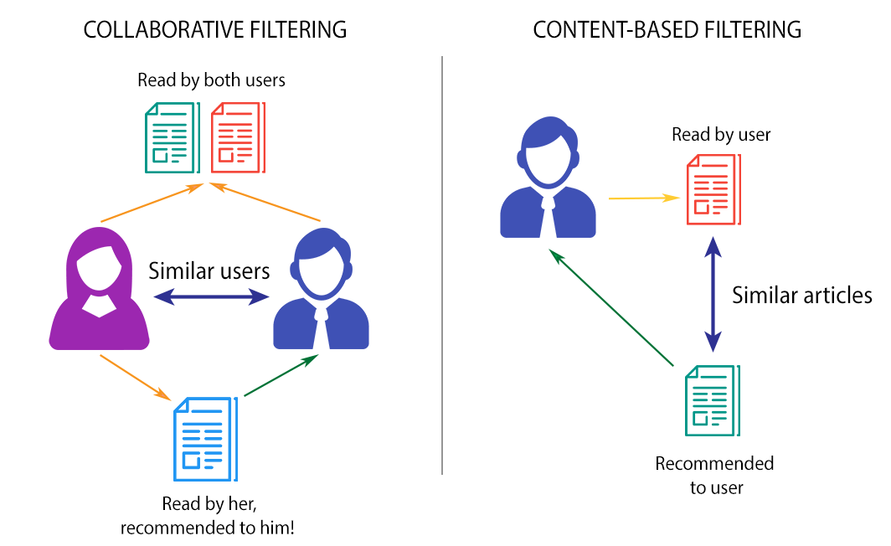
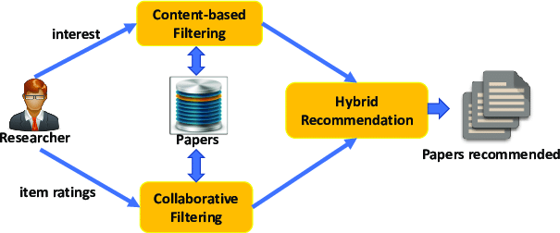
AI Approach to Solution
Book Recommender Systems
Hybrid Filtering-Content & Collaborative
Why? Solution value proposition
How Does this solve the problem?
How do we know it solves the problem?
Image Source: https://towardsdatascience.com/brief-on-recommender-systems-b86a1068a4dd

Slide 7
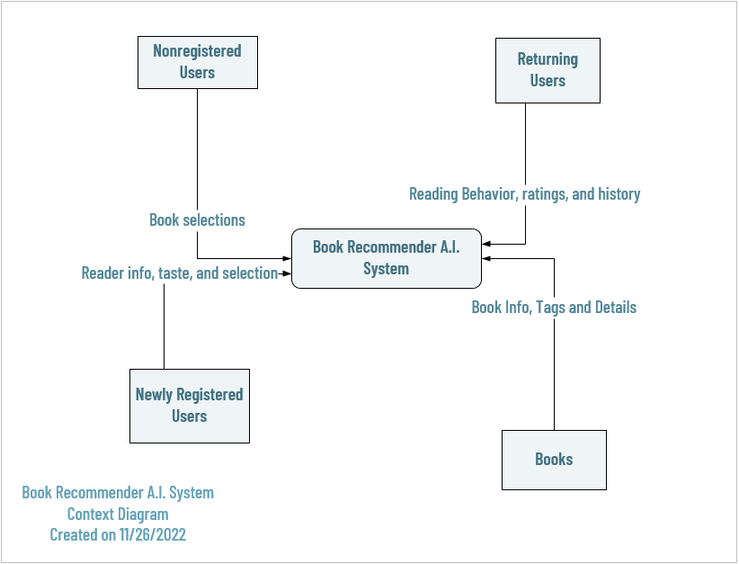
AI Algorithm Architecture
Who is the user?
Input data and source
Process
System Output
Output scenario and desired effect
How the system interacts with the reader.

Slide 8
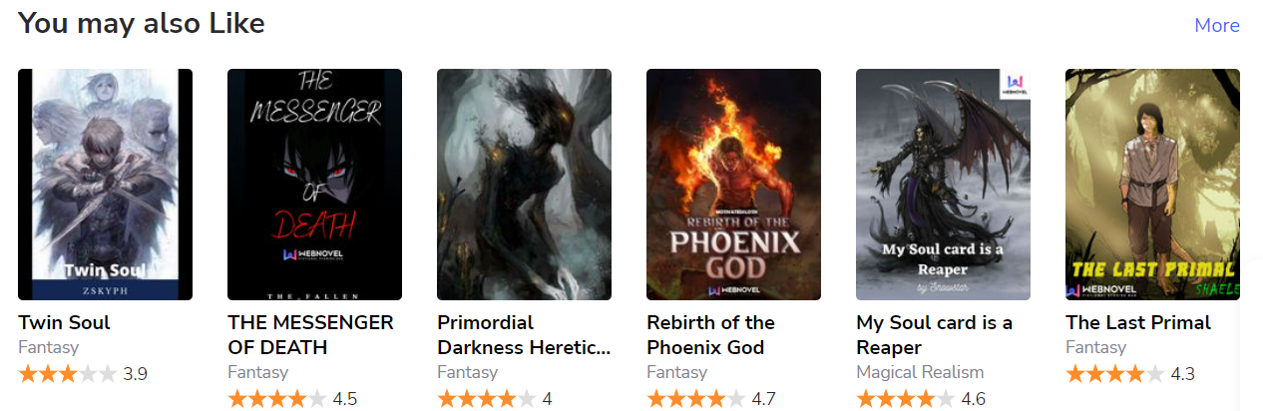
Prototype
Final Model recommends titles based on a collaborative and content based filtering techniques (Hybrid Filtering).
Working Prototype: https://colab.research.google.com/drive/1C2IoJpXbZdpNk3FTeAbmg9FFisCOXr6L
Image Source:https://www.webnovel.com/

Slide 9
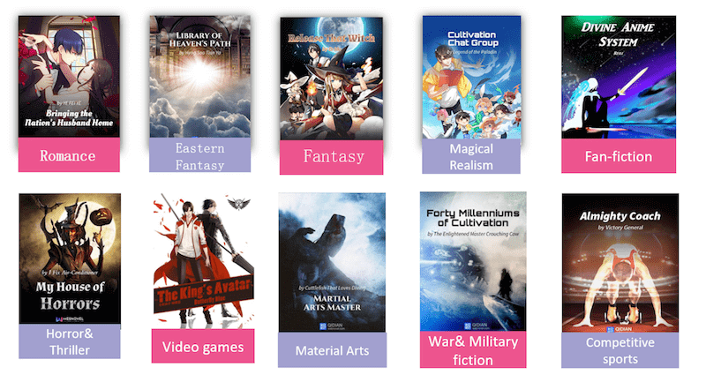
In Conclusion
Image Source:https://iconicmnl.com/webnovel-ph/
Martial Arts

Slide 10
References
Rocca, B., & Rocca, J. (2019, June 12). Introduction to recommender systems. Medium. Retrieved October 21, 2022, from https://towardsdatascience.com/introduction-to-recommender-systems-6c66cf15ada
Verma, Y. (2021, October 20). A guide to building hybrid recommendation systems for beginners. Analytics India Magazine. Retrieved October 26, 2022, from https://analyticsindiamag.com/a-guide-to-building-hybrid-recommendation-systems-for-beginners/
Villani, P. (2021, November 19). AI-powered recommendations for media, books, blogs: Algolia. Algolia Blog. Retrieved October 22, 2022, from https://www.algolia.com/blog/ai/ai-powered-recommendations-for-media-books-blogs-articles-publications/
Agrawal, R. (2022, July 26). Book recommendation system: Build A book recommendation system. Analytics Vidhya. Retrieved October 22, 2022, from https://www.analyticsvidhya.com/blog/2021/06/build-book-recommendation-system-unsupervised-learning-project/
Webnovel.com Traffic Analytics & Market Share. Similarweb. (n.d.). Retrieved October 23, 2022, from https://www.similarweb.com/website/webnovel.com/#overview
Webnovel - Tech Stack, Apps, Patents & Trademarks. (n.d.). Crunchbase. Retrieved October 23, 2022, from https://www.crunchbase.com/organization/webnovel/technology

